Slide 1

Java Threads

Slide 2
What is a Thread?
Individual and separate unit of execution that is part of a process
The term thread derives from the phrase thread of execution in operating systems
Multiple threads can work together to accomplish a common goal
Video Game example
one thread for graphics
one thread for user interaction
one thread for networking
Video Game
Process
video
networking
interaction

Slide 3
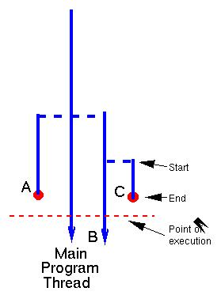
Thread ecology in a java program
started by java from main(String[])
started by main thread
started by B thread
lifetime of C thread

Slide 4
Thread ecology in a java program
When we execute an application:
The JVM creates a Thread object whose task is defined by the main() method
The JVM starts the thread
The thread executes the statements of the program one by one
After executing all the statements, the method returns and the thread dies

Slide 5
Multiple Threads in an Application
Each thread has its private run-time stack
If two threads execute the same method, each will have its own copy of the local variables the methods uses
However, all threads see the same dynamic memory, i.e., heap (are there variables on the heap?)
Two different threads can act on the same object and same static fields concurrently

Slide 6
Creating Threads
There are two ways to create our own Thread object
Subclassing the Thread class and instantiating a new object of that class
Implementing the Runnable interface
In both cases the run() method should be implemented
Advantage of Using Runnable
remember - can only extend one class
implementing runnable allows class to extend something else

Slide 7
1.
public class ThreadExample extends Thread {
public void run () {
for (int i = 1; i <= 100; i++) {
System.out.println(“---”);
}
}
}
2.
public class RunnableExample implements Runnable {
public void run () {
for (int i = 1; i <= 100; i++) {
System.out.println (“***”);
}
}
}

Slide 8
Starting the Threads
public class ThreadsStartExample {
public static void main (String argv[]) {
new ThreadExample ().start ();
new Thread(new RunnableExample ()).start ();
}
}

Slide 9
Thread State Diagram
Alive
Running
new ThreadExample();
while (…) { … }
New Thread
Runnable
Dead Thread
thread.start();
run() method returns
Blocked
Object.wait()
Thread.sleep()
blocking IO call
waiting on a monitor

Slide 10
The Thread Class

Slide 11
Thread Priority
Every thread has a priority
When a thread is created, it inherits the priority of the thread that created it
The priority values range from 1 to 10, in increasing priority
The priority can be adjusted subsequently using the setPriority() method
The priority of a thread may be obtained using getPriority()
Priority constants are defined:
MIN_PRIORITY=1
MAX_PRIORITY=10
NORM_PRIORITY=5

Slide 12
Daemon Threads
Daemon threads are “background” threads, that provide services to other threads, e.g., the garbage collection thread
The Java VM will not exit if non-Daemon threads are executing
The Java VM will exit if only Daemon threads are executing
Daemon threads die when the Java VM exits

Slide 13
ThreadGroup
The ThreadGroup class is used to create groups of similar threads. Why is this needed?
“Thread groups are best viewed as an unsuccessful experiment, and you may simply ignore their existence.”
Joshua Bloch, software architect at Sun

Slide 14
Concurrency (Synchronization)
An object in a program can be changed by more than one thread
Understand the issue with concurrent access to shared data?
Data could be a counter (int) or a data structure (e.g. a Map or List or Set)
A race condition: Two threads will access something. They “compete” causing a problem
A critical section: a block of code that can only be safely executed by one thread at a time
A lock: an object that is “held” by one thread at a time, then “released”

Slide 15
Synchronization
Any object can serve as a lock
Separate object: Object myLock = new Object();
Current instance: the this object
Enclose lines of code in a synchronized block synchronized(myLock) { // code here }
More than one thread could try to execute this code, but one acquires the lock and the others “block” or wait until the first thread releases the lock

Slide 16
Monitors
Each object has a “monitor” that is a token used to determine which application thread has control of a particular object instance
In execution of a synchronized method (or block), access to the object monitor must be gained before the execution
Access to the object monitor is queued
Entering a monitor is also referred to as locking the monitor, or acquiring ownership of the monitor
If a thread A tries to acquire ownership of a monitor and a different thread has already entered the monitor, the current thread (A) must wait until the other thread leaves the monitor

Slide 17
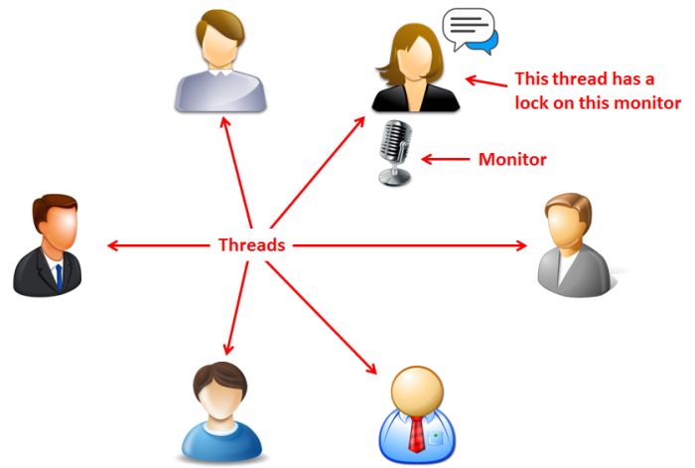
Monitors
As shown in the above figure, the threads are the people, the microphone is the monitor and the acquisition of the microphone is the lock. The threads need to acquire a lock on the monitor before they can talk (execute). Without the lock on the monitor the thread will not execute. Therefore a monitor is another object used to control who goes next. In the above example, only the thread represented by the female person has the lock and thus only it is executing. The other threads, represented by the other persons have to wait.

Slide 18
Example
public class BankAccount {
private float balance;
public synchronized void deposit(float amount){
balance += amount;
}
public synchronized void withdraw(float amount){
balance -= amount;
}
}

Slide 19
The Followings are Equivalent
public synchronized void a() {
//… some code …
}
public void a() {
synchronized (this) {
//… some code …
}
}

Slide 20
Static Synchronized Methods
Marking a static method as synchronized, associates a monitor with the class itself
The execution of synchronized static methods of the same class is mutually exclusive.

Slide 21
The Followings are Equivalent
public static synchronized void a() {
//… some code …
}
public void a() {
synchronized (this.getClass()) {
//… some code …
}
}

Slide 22
Deadlock
Sometimes two or more threads need to acquire the locks on several shared objects.
This could cause deadlock, in which each thread has the lock on one of the objects and is waiting for the lock on the other object.
In the figure below, the two threads wait for each other to release the in order to get a lock, and neither can continue to run.

Slide 23
Preventing Deadlock
Deadlock can be easily avoided by resource ordering.
With this technique, assign an order on all the objects whose locks must be acquired and ensure that the locks are acquired in that order.
How does this prevent deadlock in the previous example?

Slide 24
wait(), notify(), and notifyAll()
Allows threads to cooperate
Use the wait(), notify(), and notifyAll() methods to facilitate communication among threads.
The wait(), notify(), and notifyAll() methods must be called in a synchronized method or a synchronized block on the calling object of these methods. Otherwise, an IllegalMonitorStateException would occur.
The wait() method lets the thread wait until some condition occurs. When it occurs, you can use the notify() or notifyAll() methods to notify the waiting threads to resume normal execution. The notifyAll() method wakes up all waiting threads, while notify() picks up only one thread from a waiting queue.

Slide 25
Example
The wait(), notify(), and notifyAll() methods must be called in a synchronized method or a synchronized block on the receiving object of these methods. Otherwise, an IllegalMonitorStateException will occur.
When wait() is invoked, it pauses the thread and simultaneously releases the lock on the object. When the thread is restarted after being notified, the lock is automatically reacquired.
The wait(), notify(), and notifyAll() methods on an object are analogous to the await(), signal(), and signalAll() methods on a condition.

Slide 26
Exercise
Write a class Main.java with at least 3 classes
public class Main{…} , class ThreadA, class ThreadB
ThreadA extends Thread, whose run() method will randomly and repeatedly println “You say hello” or “You say good morning” to the console, until interrupted by Main
ThreadB extends Thread, whose run() method will println “I say good bye” or “I say good night” to the console depending on whether ThreadA said “…hello” or “…good moring”, until it is interrupted (or informed) by ThreadA.
Main is the main class, whose main(…) method will
create an instance of ThreadA and an instance of ThreadB and start them.
read a char from the console
interrupt threadA, which will then interrupt (and terminate )threadB, and then terminate (by running to completion ) itself. (notes: don’t use stop() method).
Requirement: ThreadA and threadB must be executed in such a way that
The output is started with a “…hello” or “…good morning“ line said by A,
Every line said by A is followed by a corresponding line said by B, which, unless is the last line, is followed by a line said by A .
The output is ended with a line said by B.
To avoid too many messages shown in the console in a short time, you threads are advised to sleep() for a short time after printing a message.

Slide 27
A candidate Main class
public class Main {
public static void main(Sting[] args) {
Thread a = new ThreadA();
Thread b = new ThreadB();
a.setPartner(b); a.start(); b.start();
try{ System.out.println(“type any key to terminate:”);
System.in.read();
}catch ( Exception e) { }
a.interrupt();
try{ a.join(); } catch(Exception e){ }
}
}
Note: You may change the content of Main if it does not meet your need.

